Slide 1
Data science
Data Engineering -- Machine learning -- Operations

Slide 2
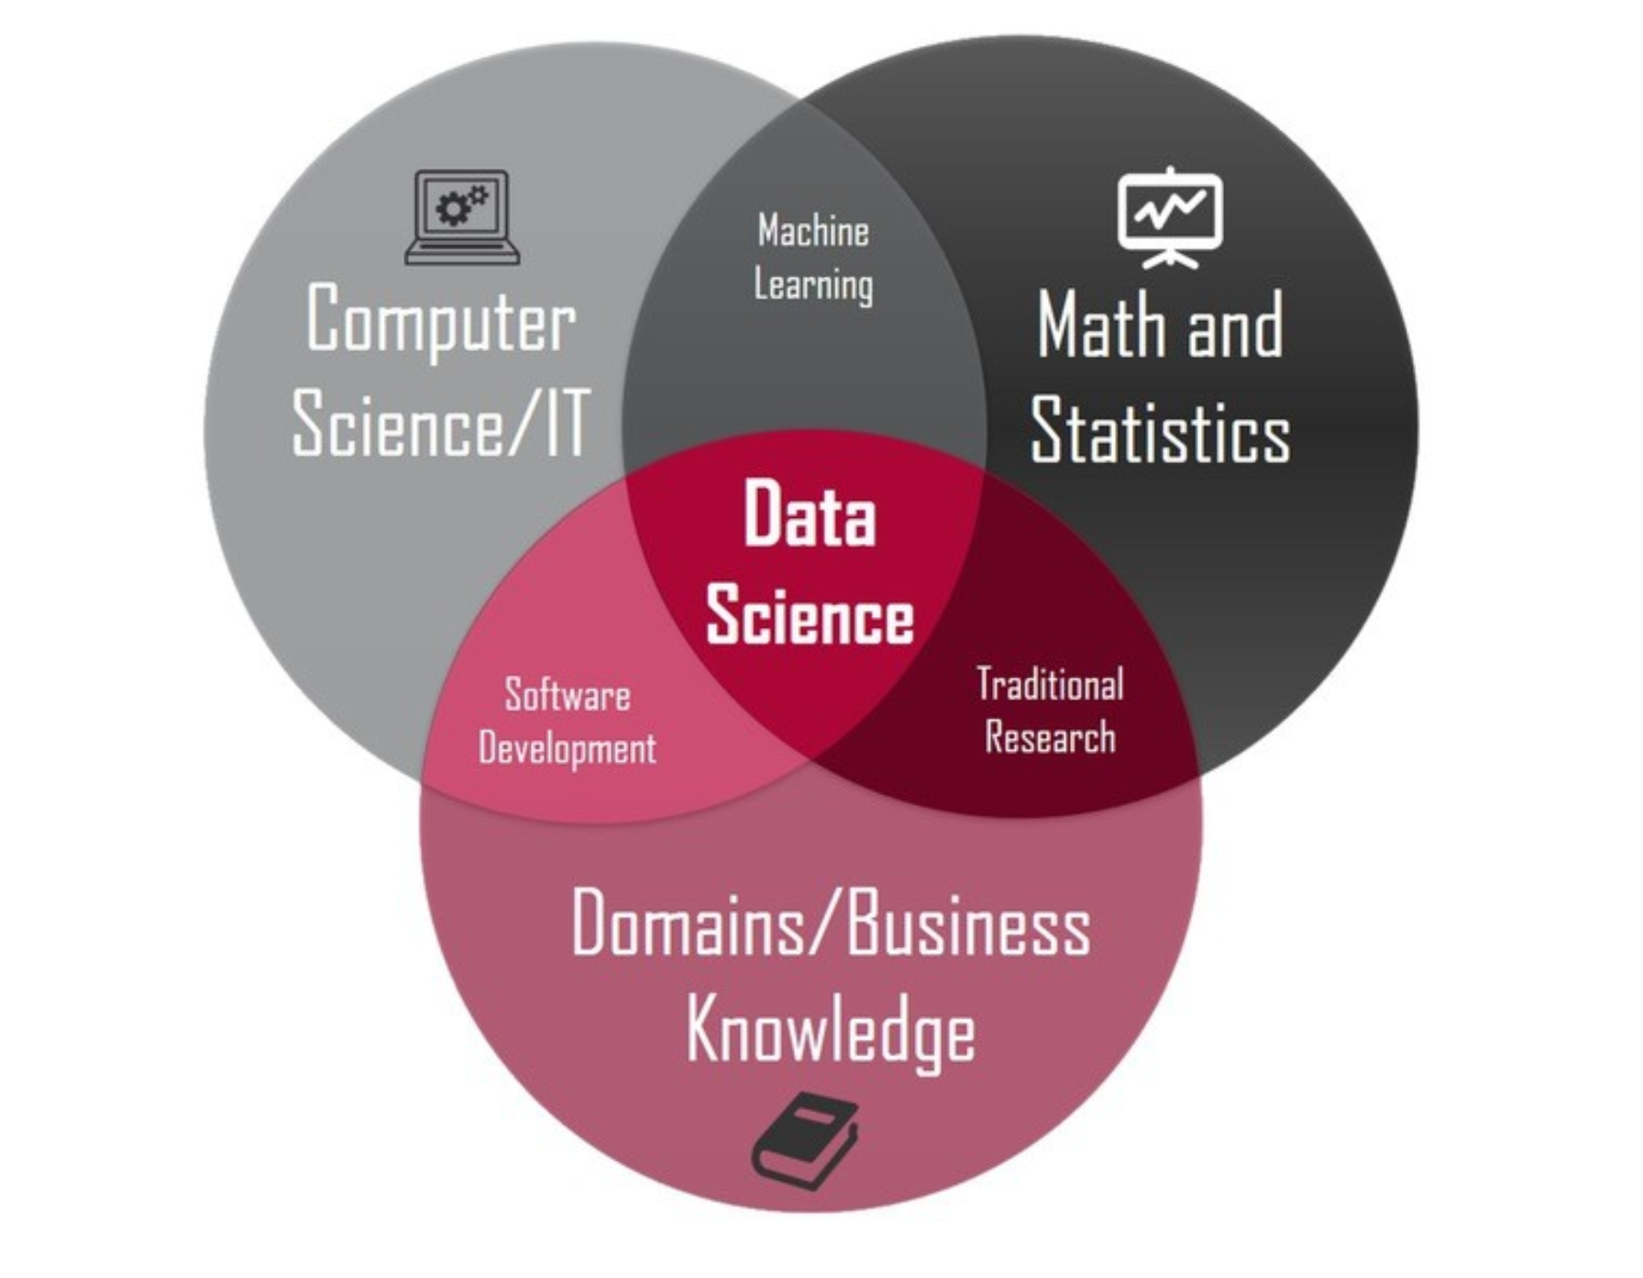
What is it ?

Slide 3
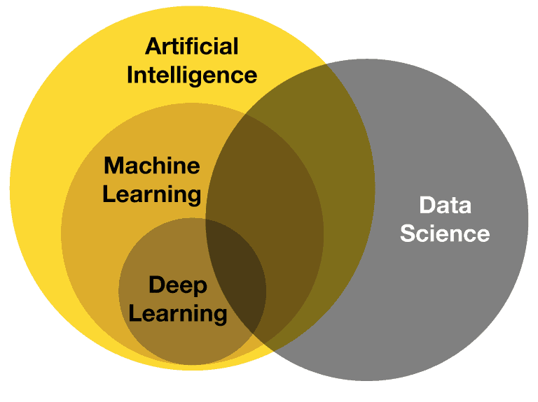
What is it ?

Slide 4
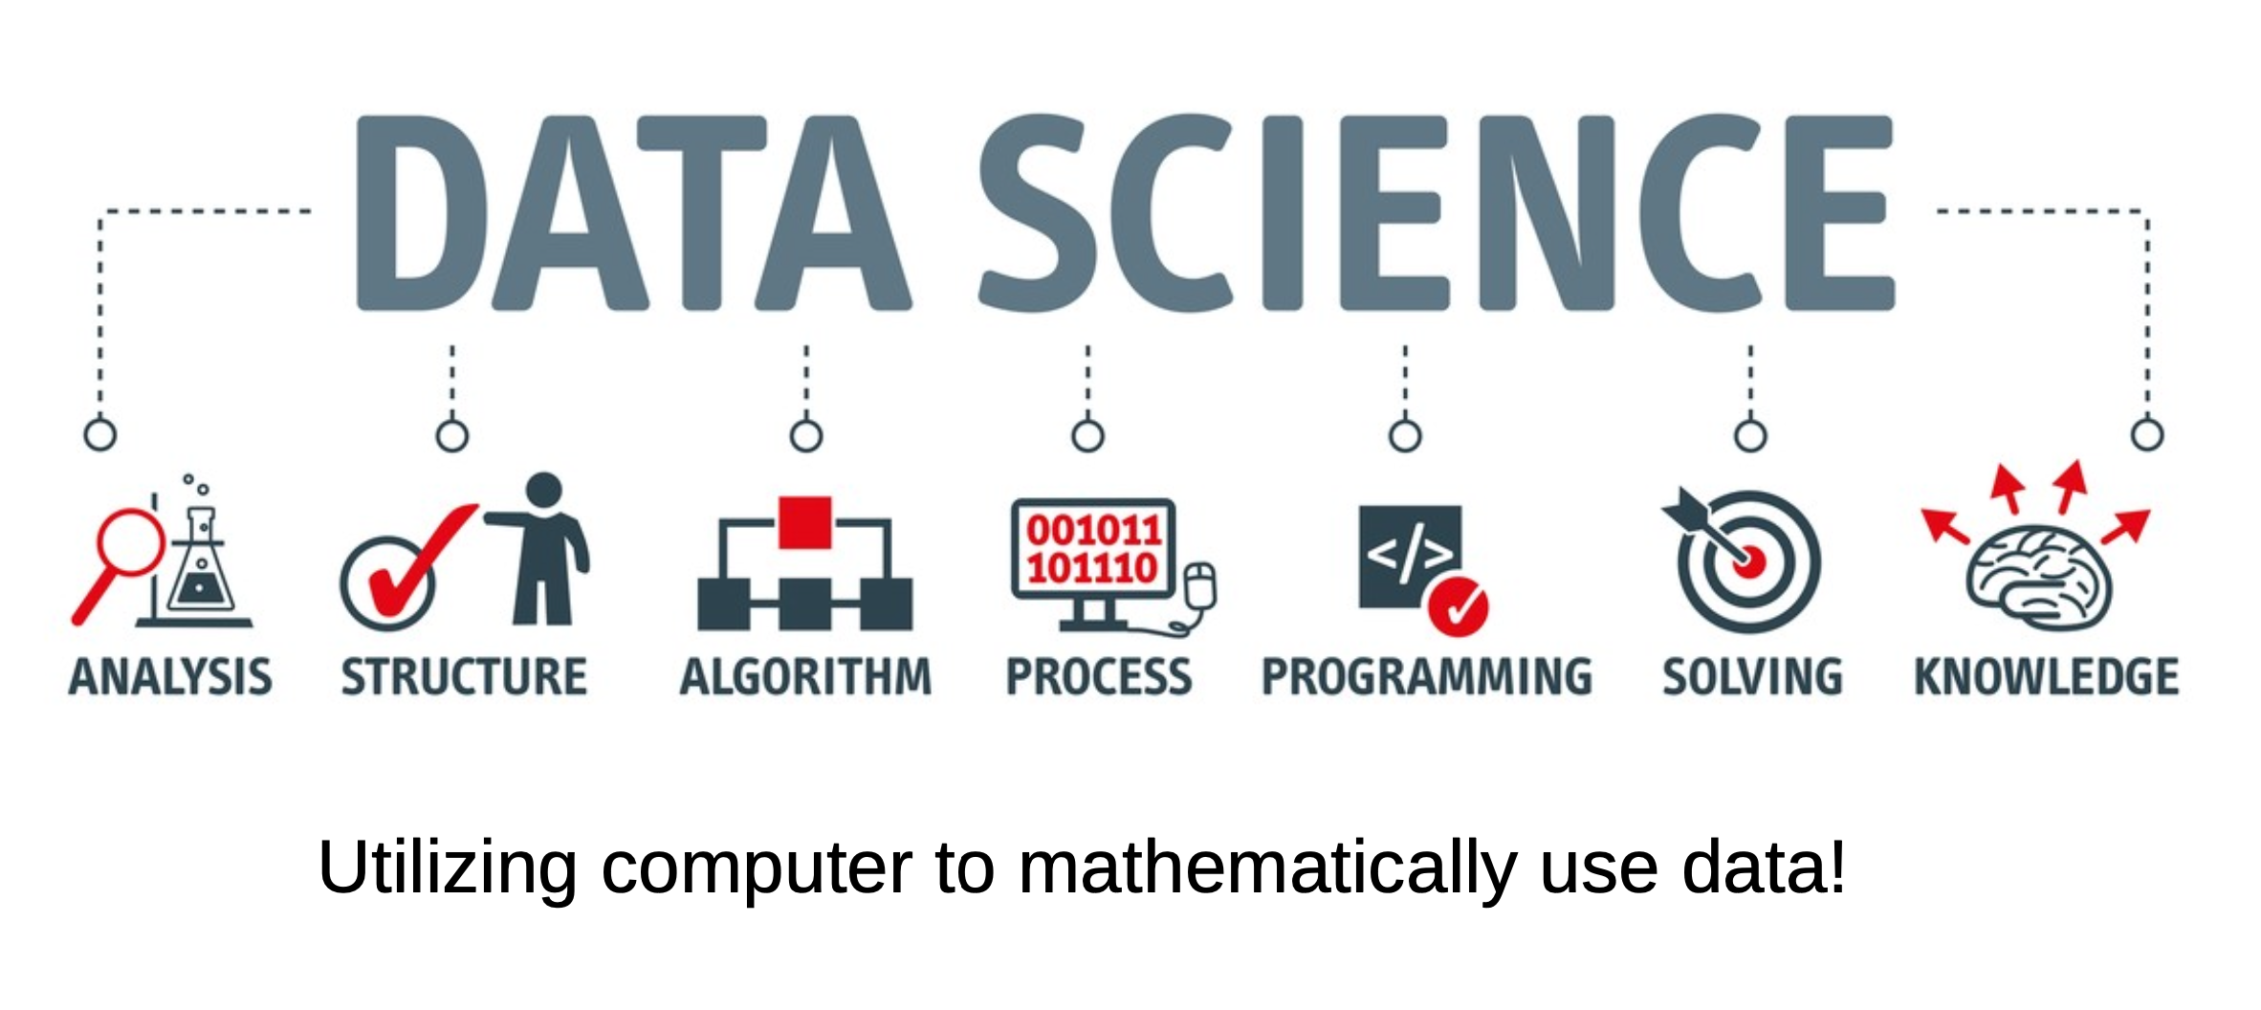
What is the problem?

Slide 5
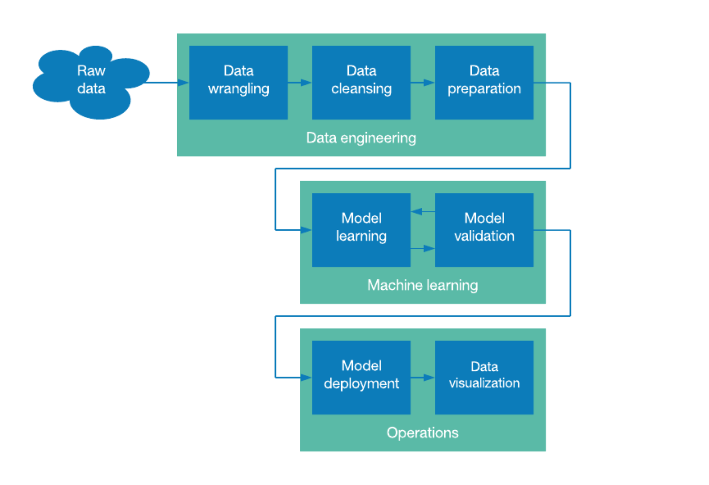
Data Science Pipeline

Slide 6
Data Science Pipeline
Key Steps in Data Wrangling:
Data Cleaning:
Handling Missing Values: Identifying and addressing gaps in the dataset, either by filling in missing values or removing incomplete records.
Removing Duplicates: Identifying and eliminating duplicate entries to ensure data integrity.
Correcting Errors: Fixing inconsistencies, such as typos or incorrect data types.
Data Transformation:
Normalization: Scaling data to a standard range or distribution.
Encoding: Converting categorical variables into numerical formats (e.g., one-hot encoding).
Aggregation: Summarizing data at a higher level, such as calculating averages or totals.
Data Structuring:
Reshaping: Changing the format of the data (e.g., pivoting tables, melting).
Joining/Merging: Combining data from different sources or tables to create a comprehensive dataset.
Data Enrichment:
Adding Context: Incorporating external datasets to provide additional information or insights.
Feature Engineering: Creating new variables that can enhance model performance.

Slide 7
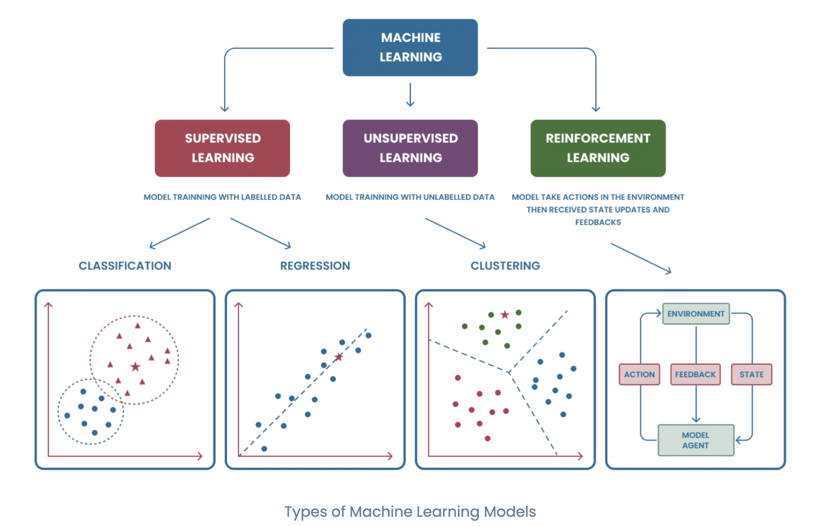
ModeL LEARNING ML TYPES

Slide 8
SuperVISED MACHIN LEARNING
Regression
- The main idea of linear regression is to model the relationship between a dependent variable (often called the target or response variable) and one or more independent variables (predictors or features) using a linear equation.
- find a better model than Mean
Classification
- find a model to act better random classifier

Slide 9
What we need
● Math
– Linear Algebra
– Analytics
– Stochastic Processes (Probabilities)
● Computer
– Databases (SQL, NoSQL)
– API (REST, JSON RPC)
– Programing Language (Python)
– Libraries

Slide 10
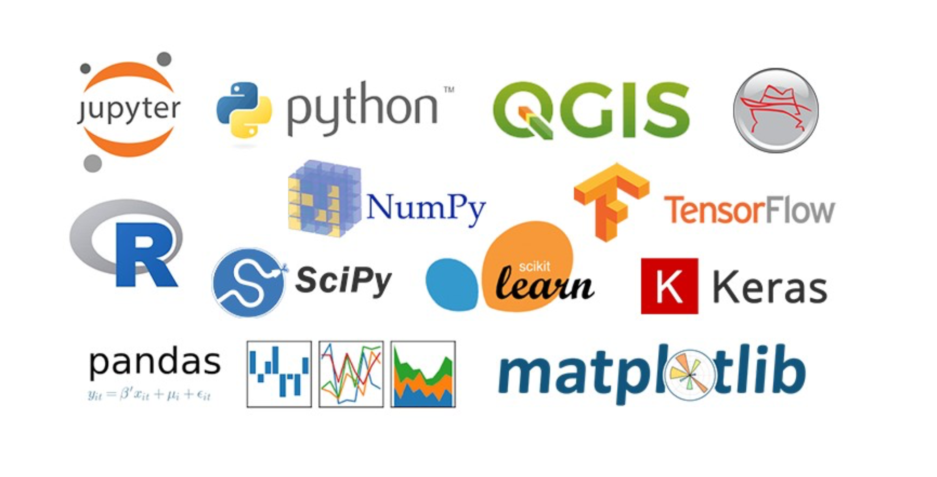
Libraries

Slide 11
Libraries (cont.)
Linear Algebra: numpy
Scientific basic tools: scipy
Symbolic Tools: sympy
Visualization Tools: matplotlib, seaborn, plotly
Machine Learning Tools: scikit-learn – apache spark mlib
Deeplearning: Tensorflow( Keras) – PyTorch
Computer Vision: opencv
NLP: nltk, hazm
Reporting and sharing: jupyter

Slide 12
What we do
Find a formula to descibe data
Y = f(x)
Y = ax1 +bx2+ c
SLR Using a straight line, simple linear regression establishes the relationship between two variables - dependent and independent. Independent and dependent variables are terms used to describe the relationship between two or more variables.

Slide 13
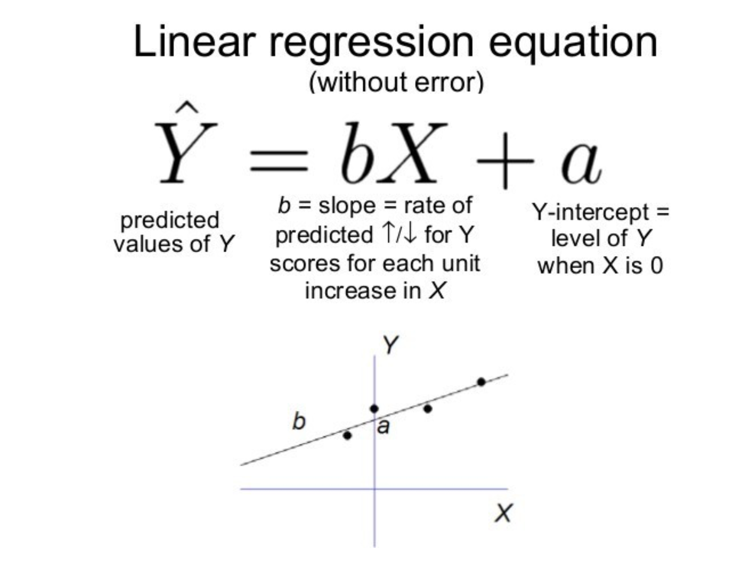
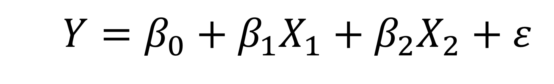
What we do

Slide 14
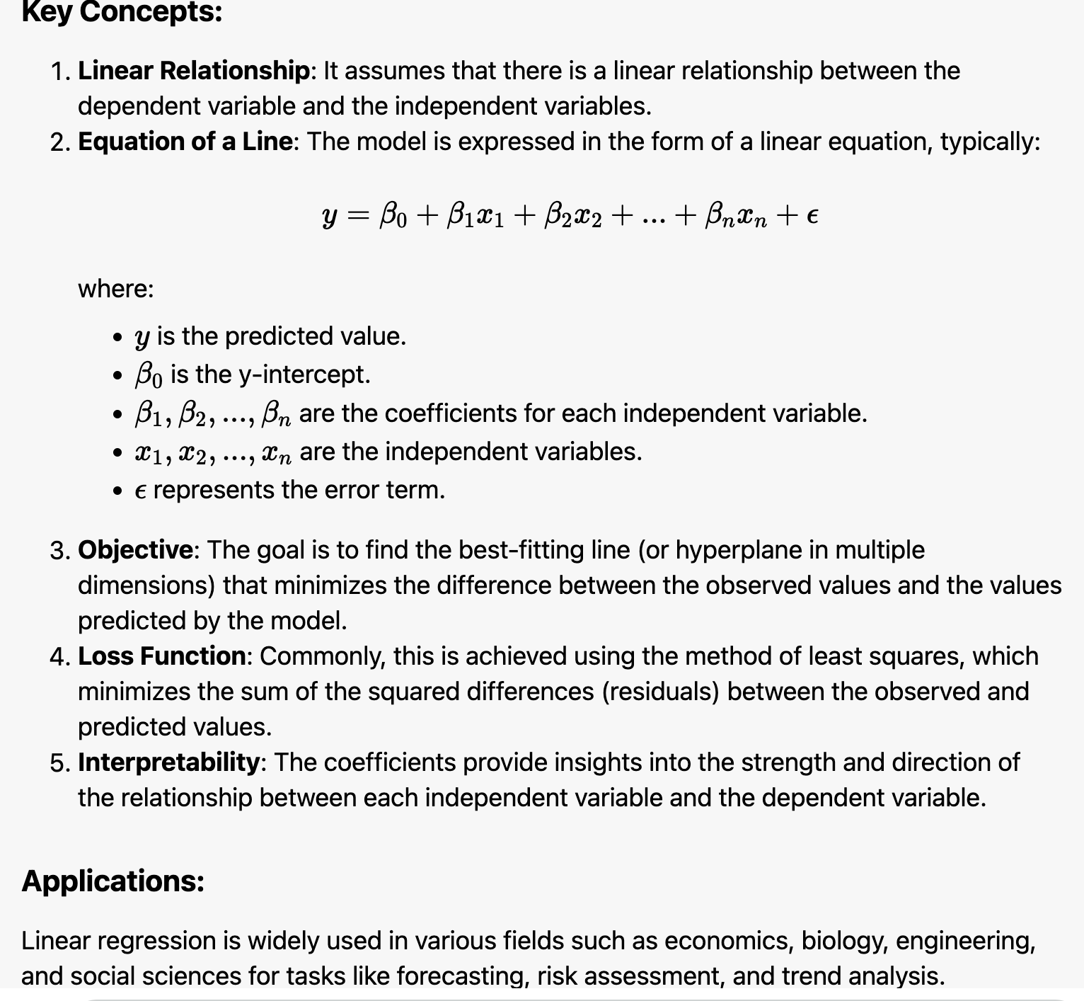
What we do

Slide 15
What we do
Find equivalence between Generalization and Accuracy
Example :
Simple fake Regression sample
Find type of iris flower base on data
Find fraud transaction from transaction data
…

Slide 16
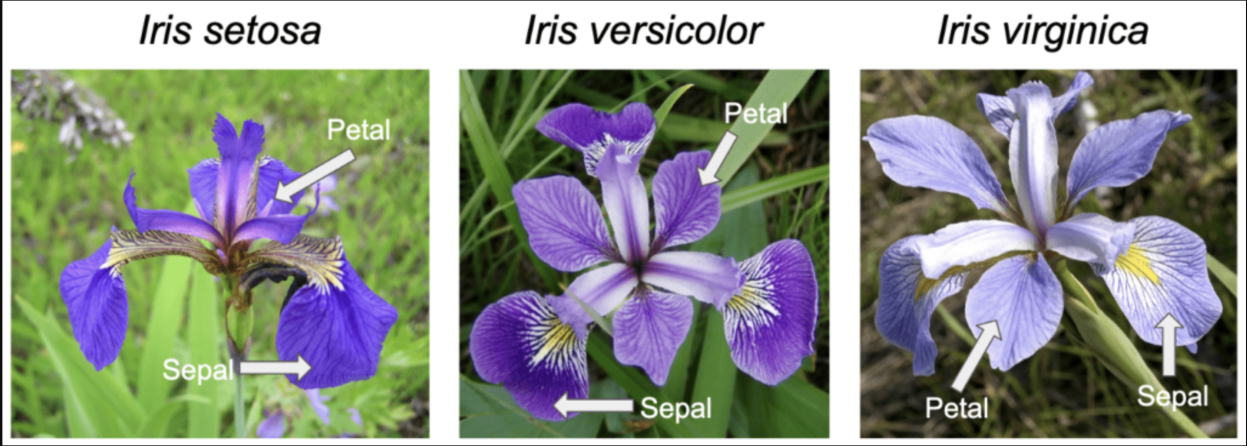
Example IrIs
Classification example
Iris flower classification is a very popular machine learning project. The iris dataset contains three classes of flowers, Versicolor, Setosa, Virginica, and each class contains 4 features, 'Sepal length', 'Sepal width', 'Petal length', 'Petal width’.
https://github.com/Apaulgithub/oibsip_taskno1

Slide 17
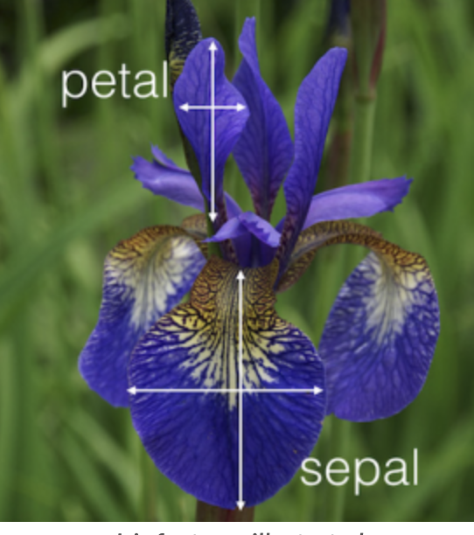
Example IrIs
Features definition
There are 4 features in this dataset:
1.sepal length,2. sepal width,
3.petal length,4. petal width;
and 3 classes:1. Setosa,2. Versicolor, 3.Virginica.
You can see in the picture below how they relate to the actual flower.

Slide 18
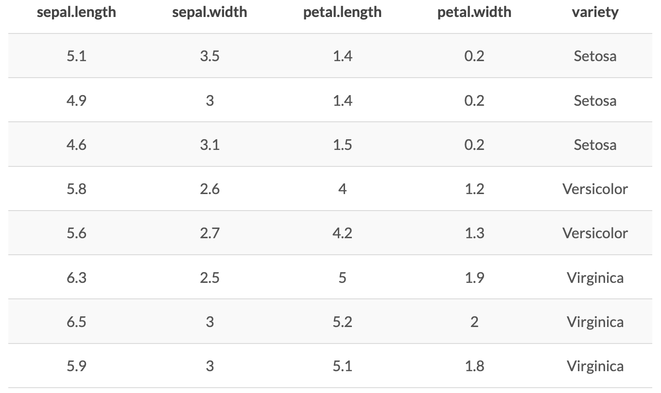
Example IrIs Sample DataSET

Slide 19
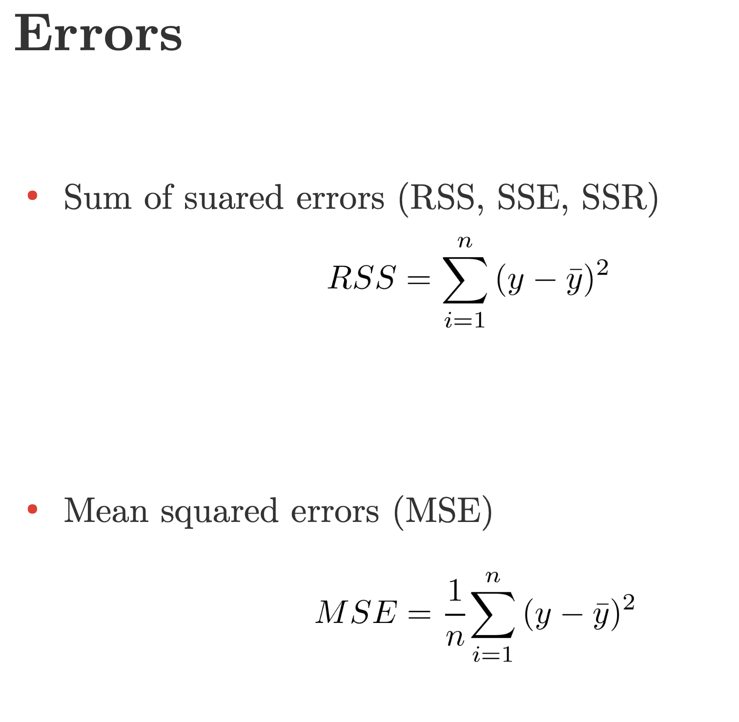
Errors

Slide 20
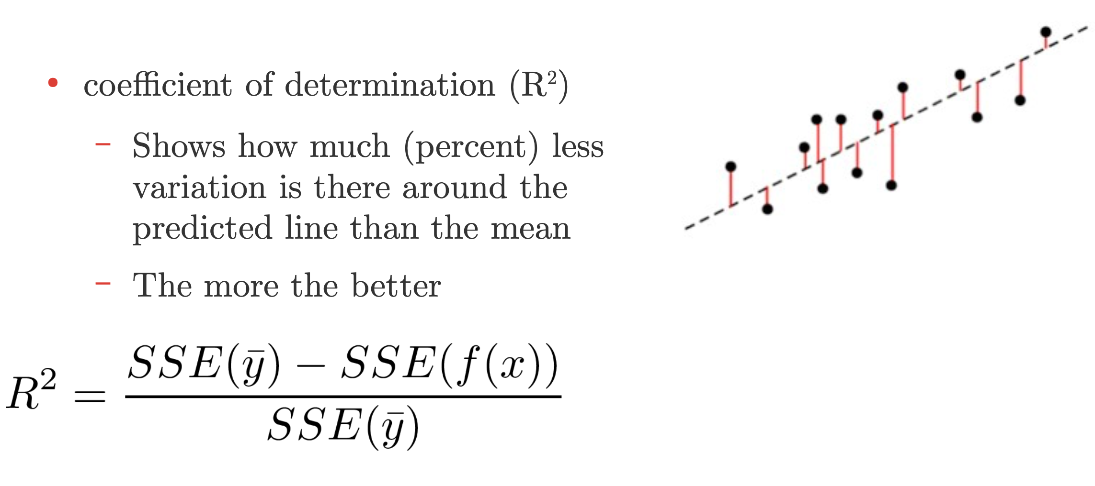
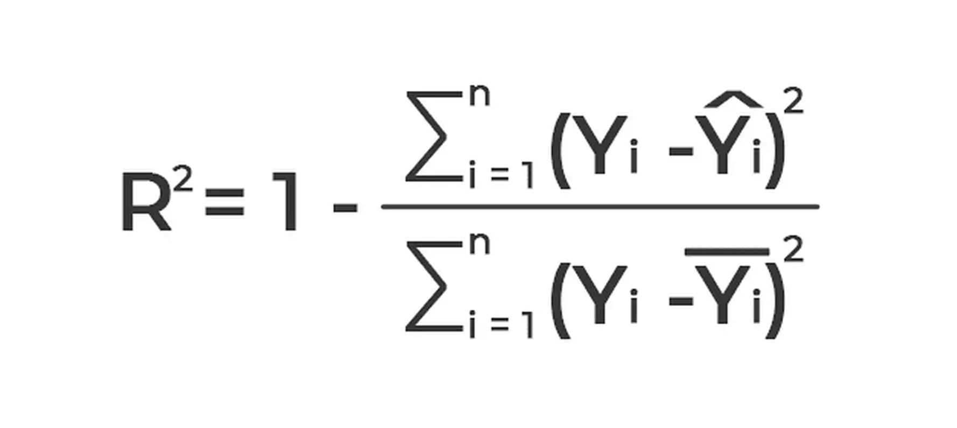
R2
Definition. The coefficient of determination, or R2 , is a measure that provides information about the goodness of fit of a model. In the context of regression it is a statistical measure of how well the regression line approximates the actual data.

